Slide 2
Will I be okay? Predicting and preventing longitudinal co-morbidities of HIV among pediatric and adolescent populations
Dr. Irene Njuguna
@GlobalWACh
Share your thoughts on this presentation with #IAS2019

Slide 3
No conflicts of interest

Slide 4

Outline
ART benefits in children
Pathogenesis of organ damage
Neurodevelopment
  Childhood
  School age
  Adolescence
Potential therapies
Photo credit: Namibia disclosure booklet

Slide 5
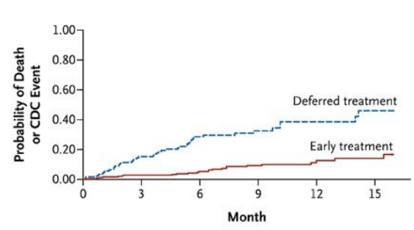
Early ART improves survival and prevents morbidity
Benefits of ART
Neurodevelopment
Growth
Opportunistic infections
Violari 2008, Laughton 2018, McGrath 2015, B-Lajoie 2016

Slide 6
Early ART improves survival and prevents morbidity
Benefits of ART
Neurodevelopment
Growth
Opportunistic infections
Is ART enough?
Violari 2008, Laughton 2018, McGrath 2015, B-Lajoie 2016

Slide 7
Persistent inflammation results to end organ damage
Immune activation and persistent inflammation
Deeks 2013, Innes 2018, Cervia 2010, French 2009

Slide 8

Persistent inflammation results to end organ damage
Immune dysfunction
Immune activation and persistent inflammation
Image credit: https:www.dreamstime.com/immunity-system-line-icon-human-immune-vector-design-virus-bacteria-illustration-logo-template-image132640864
Tobin 2013

Slide 9
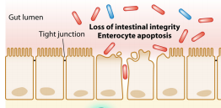
Persistent inflammation results to end organ damage
Immune dysfunction
Microbial translocation
Immune activation and persistent inflammation
Deeks 2013, Marchetti 2013

Slide 10


Persistent inflammation results to end organ damage
Immune dysfunction
Microbial translocation
Viral replication
Immune activation and persistent inflammation
Co-infections
Image credit: https://www.vectorstock.com/royalty-free-vector/viruses-bacteria-and-germs-icon-set-vector-19593199
Martinez-Picado 2016, Boulogoura 2016

Slide 11
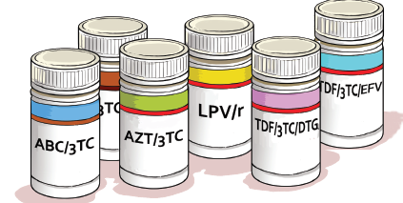
Persistent inflammation results to end organ damage
Immune dysfunction
Microbial translocation
Viral replication
Immune activation and persistent inflammation
Co-infections
ART toxicity
Innes 2018

Slide 12

Persistent inflammation results to end organ damage
Immune dysfunction
Microbial translocation
Viral replication
Immune activation and persistent inflammation
Co-infections
ART toxicity
Traditional risk factors
Deeks 2013

Slide 13
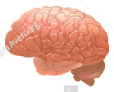
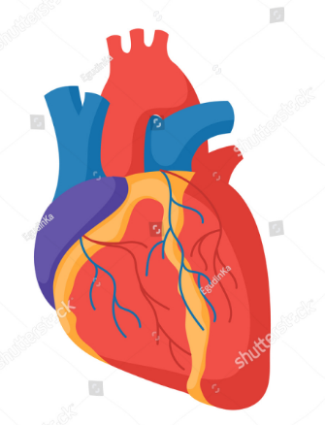
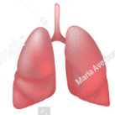
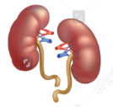
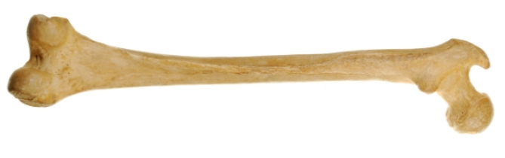
Persistent inflammation results to end organ damage
Immune dysfunction
Microbial translocation
Viral replication
Immune activation and persistent inflammation
Organ damage
Brain
Heart
Lungs
Co-infections
ART toxicity
Traditional risk factors
Kidney
Image cedit: https://www.shutterstock.com/image-vector/realistic-human-organs-set-anatomy-682422079?id=682422079&irgwc=1&utm_medium=Affiliate&utm_campaign=Kratochvil&utm_source=39150&utm_term= https://onlinesciencenotes.com/structure-functions-bones/
Deeks 2013
Bone

Slide 14
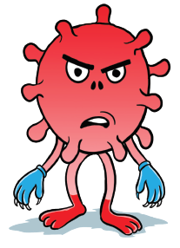
Persistent inflammation results to end organ damage
Immune dysfunction
Microbial translocation
Direct effect of HIV, ART, co-infections
Viral replication
Immune activation and persistent inflammation
Organ damage
Brain
Heart
Lungs
Co-infections
ART toxicity
Traditional risk factors
Kidney
Deeks 2013
Bone

Slide 15
Persistent inflammation results to end organ damage
Immune dysfunction
Microbial translocation
Direct effect of HIV, ART, co-infections
Viral replication
Immune activation and persistent inflammation
Organ damage
Brain
Heart
Lungs
Co-infections
ART toxicity
Traditional risk factors
Kidney
Deeks 2013
Bone

Slide 16
Multiple organ damage associated with HIV despite ART
Atherosclerotic vascular disease
  Elevated biomarkers
  Damage to myocytes
  Subclinical changes
    High LV wall stress
    Lower LV function
Innes 2018, Abd-Elmoniem 2014, Syed 2013, Wilkinson 2018 & 2013

Slide 17
Multiple organ damage associated with HIV despite ART
Atherosclerotic vascular disease
  Elevated biomarkers
  Damage to myocytes
  Subclinical changes
    High LV wall stress
    Lower LV function
Innes 2018, Abd-Elmoniem 2014, Syed 2013, Wilkinson 2018 & 2013
Small airway disease
  Constrictive obliterative bronchiolitis
  Bronchiectasis
Atypical asthma
LIP reduced with ART
Innes 2018, Attia 2017

Slide 18
Multiple organ damage associated with HIV despite ART
Atherosclerotic vascular disease
  Elevated biomarkers
  Damage to myocytes
  Subclinical changes
    High LV wall stress
    Lower LV function
Innes 2018, Abd-Elmoniem 2014, Syed 2013, Wilkinson 2018 & 2013
Small airway disease
  Constrictive obliterative bronchiolitis
  Bronchiectasis
Atypical asthma
LIP reduced with ART
Innes 2018, Attia 2017
Renal tubular dysfunction
HIV associated immune complex kidney disease
HIV associated nephropathy
Innes 2018, Pontrelli 2011

Slide 19
Multiple organ damage associated with HIV despite ART
Atherosclerotic vascular disease
  Elevated biomarkers
  Damage to myocytes
  Subclinical changes
    High LV wall stress
    Lower LV function
Innes 2018, Abd-Elmoniem 2014, Syed 2013, Wilkinson 2018 & 2013
Small airway disease
  Constrictive obliterative bronchiolitis
  Bronchiectasis
Atypical asthma
LIP reduced with ART
Innes 2018, Attia 2017
Low bone mineral density
Puthankit 2013
Renal tubular dysfunction
HIV associated immune complex kidney disease
HIV associated nephropathy
Innes 2018, Pontrelli 2011

Slide 20
Multiple organ damage associated with HIV despite ART
Little prevalence data at a population level
More work to better understand:
  Excess risk
  Screening technologies
5R01HD083042-02 (PI: Innes & Haubrich), BREATHE 1&2 (PI: Attia)

Slide 21
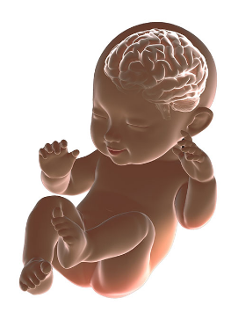
HIV and neurodevelopment
Nutrition
Nurturing
Exposure to toxins and infection
Photo credit: https://www.cdc.gov/ncbddd/childdevelopment/early-brain-development.html

Slide 22
HIV and neurodevelopment
Nutrition
Nurturing
Exposure to toxins and infection
HIV
Maternal immunity, nutrition, illness
Exposure to ART
Irreversible damage prior to ART
Inflammatory response and neuronal damage
Photo credit: https://www.cdc.gov/ncbddd/childdevelopment/early-brain-development.html
Overall poor neurodevelopmental outcomes among HIV infected children compared to HIV exposed or uninfected
McHenry 2018, Crowell 2014

Slide 23
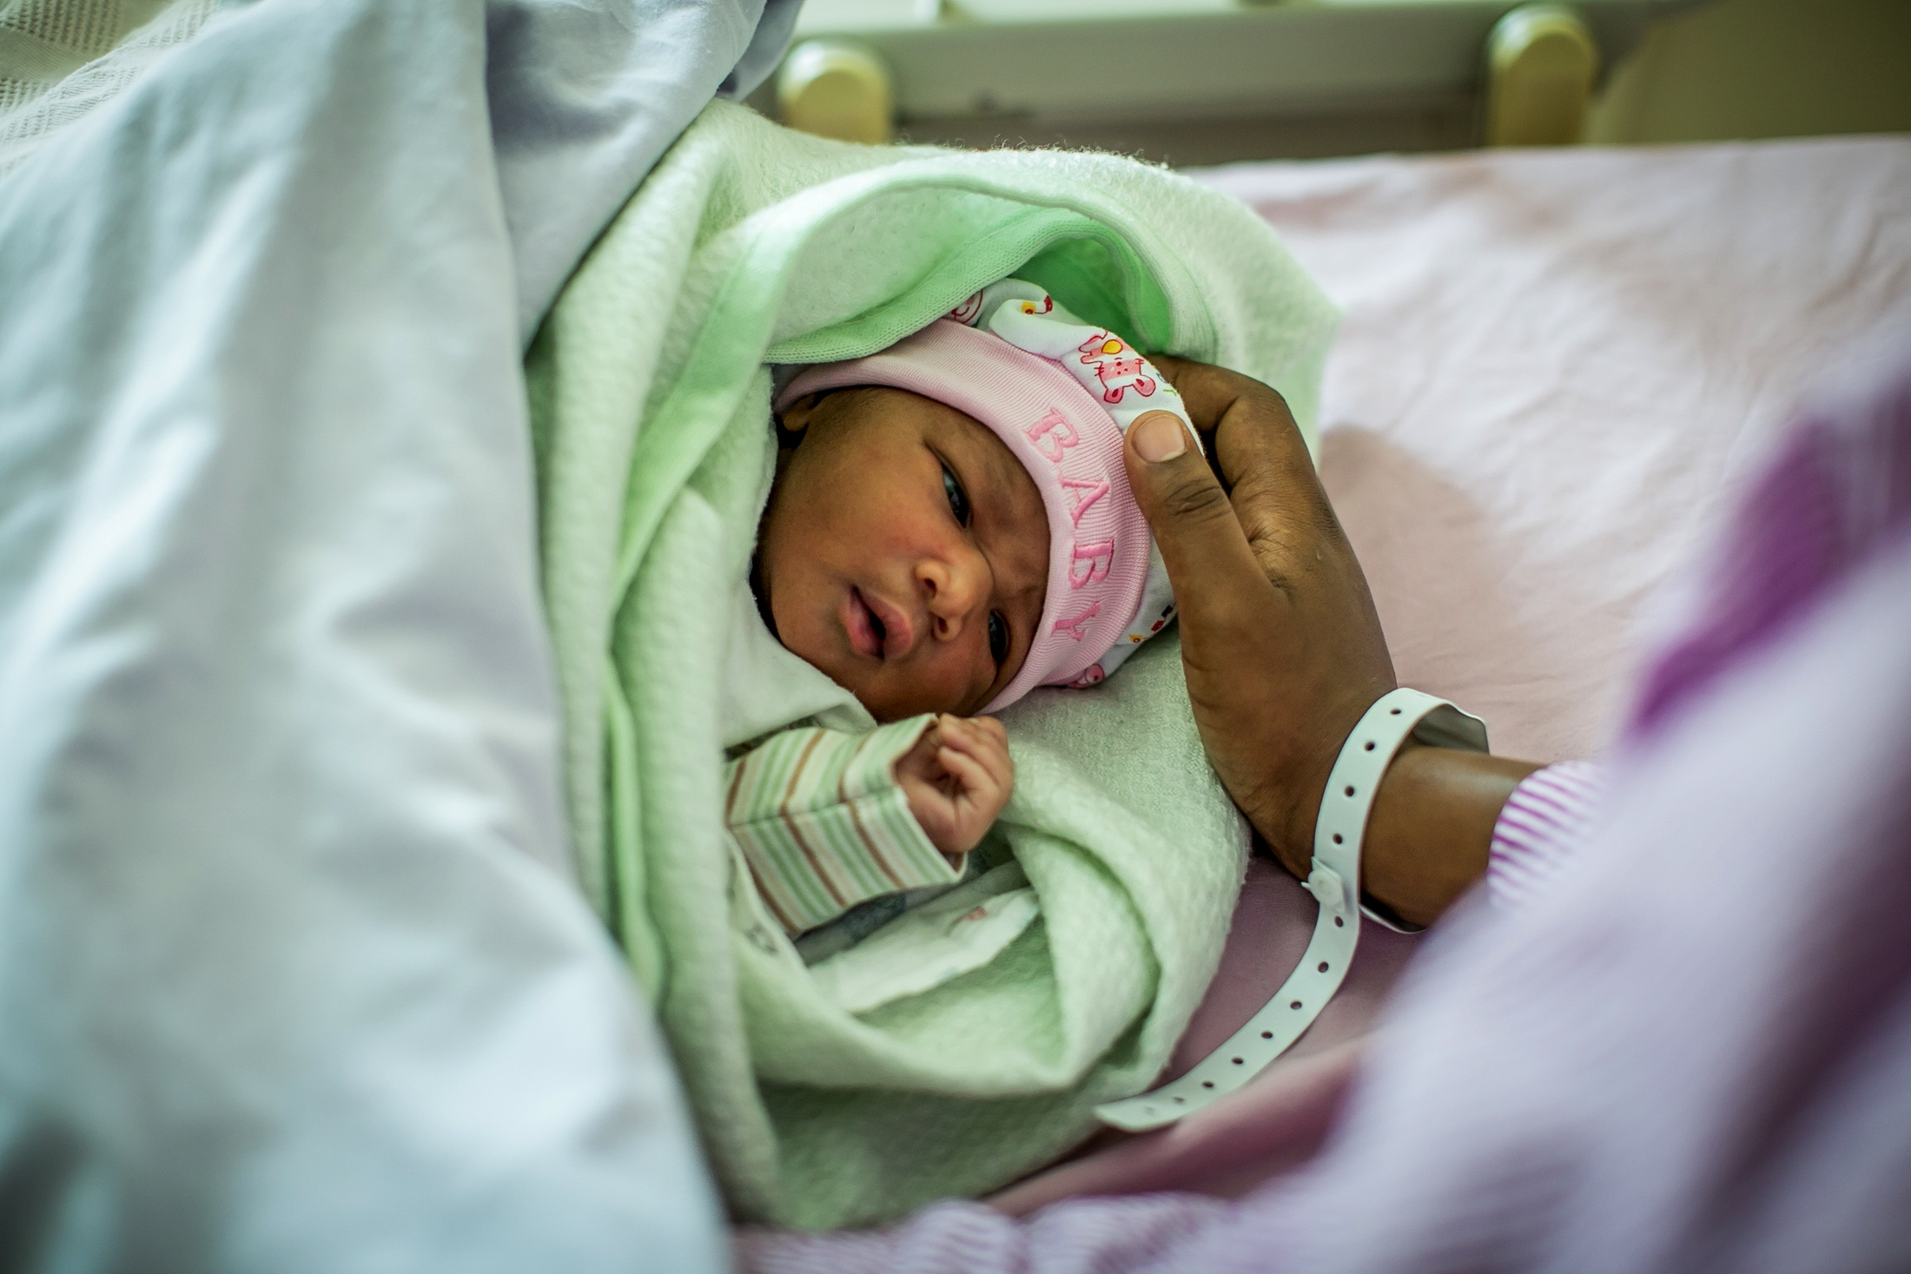
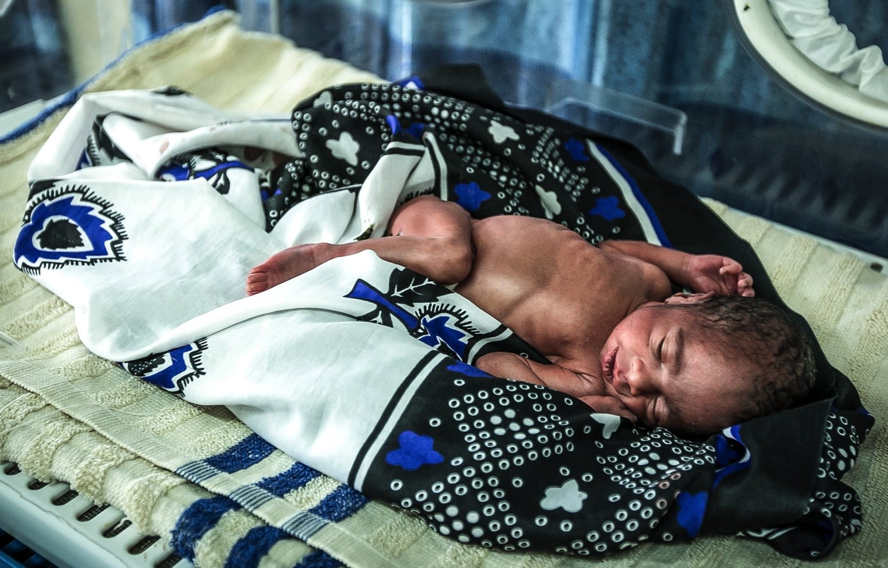
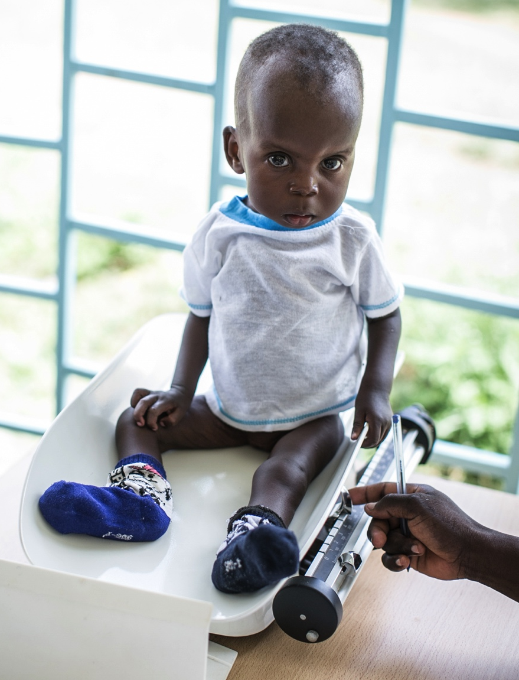
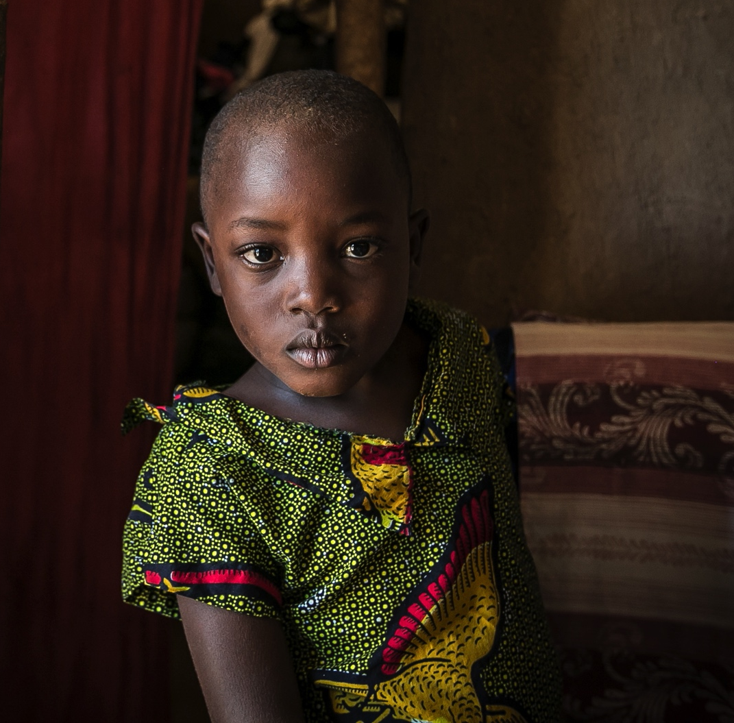
Age at ART and clinical presentation matter
Photo credit: Paul J. Brown Photography

Slide 24
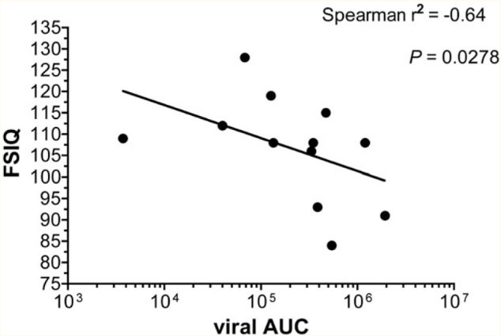
Neurocognitive outcomes correlated with early viral suppression
FSIQ: full scale intelligence quotient (Wechsler Intelligence Score for Children)
Weber 2017

Slide 25
ART at less than 1 year may improve outcomes
HIV Exposed Uninfected N=100
HIV Positive
N=50
MSEL scores
Median age 27mo (19-42)
ART at ≤ 3 months
Median age 25mo (18-30)
ART at 3-12 months
Median age 35mo (28-41)
MSEL: Mullen Scales of early learning
Jantarabenjakul 2019

Slide 26
ART at less than 1 year may improve outcomes
HIV Exposed Uninfected N=100
HIV Positive
N=50
MSEL scores
Median age 27mo (19-42)
ART at ≤ 3 months
Median age 25mo (18-30)
ART at 3-12 months
Median age 35mo (28-41)
Baseline
9%*
7%
30%*
48 weeks
16%
19%
26%
MSEL: Mullen Scales of early learning
Jantarabenjakul 2019

Slide 27
ART at less than 1 year may improve outcomes
HIV Exposed Uninfected N=100
HIV Positive
N=50
MSEL scores
Median age 27mo (19-42)
ART at ≤ 3 months
Median age 25mo (18-30)
ART at 3-12 months
Median age 35mo (28-41)
Baseline
9%*
7%
30%*
48 weeks
16%
19%
26%
Early treatment beneficial at baseline and follow-up
MSEL: Mullen Scales of early learning
Jantarabenjakul 2019

Slide 28




Early treatment benefit over long-term?
Objective: Characterize cognitive ability in HIV-infected, HIV exposed uninfected and HIV unexposed children
2007-2009
Early treated
<5 mos
5-8 yrs
2004-2006
Late treated
1.5-5 yrs
10-17 yrs
Benki-Nugent 2015-2017

Slide 29
Neurodevelopmental deficits at school age in early treated
 |  |  | Late-treated N=26
Global cognition | -0.31 | -0.89
Visuospatial processing | -0.20 | -0.75
Short-term memory | -0.42 | -1.08
Processing speed | -0.90 | -1.60
Delayed memory | -0.38 | -0.68
Planning/reasoning | -0.33 | -0.63
Motor function | -0.17 | -0.74
Estimates are mean difference in z-scores compared to HUU, adjusted for caregiver education
Benki-Nugent 2015-2017

Slide 30
Neurodevelopmental deficits at school age in early treated
 | Early-treated N=54 |  | Late-treated N=26
Global cognition | -0.31 | -0.89
Visuospatial processing | -0.20 | -0.75
Short-term memory | -0.42 | -1.08
Processing speed | -0.90 | -1.60
Delayed memory | -0.38 | -0.68
Planning/reasoning | -0.33 | -0.63
Motor function | -0.17 | -0.74
Estimates are mean difference in z-scores compared to HUU, adjusted for caregiver education
Benki-Nugent 2015-2017

Slide 31
Poor neurocognitive outcomes at adolescence but sparse data
Compared to HUU | Same | Worse | Unknown
Cognitive function |  | X
Executive function |  | X
Adaptive functioning |  |  | ?
Language and hearing |  | X
Academic achievement |  |  | ?
Secondary physical disability |  |  | ?
Mental health problems |  | X
Laughton 2013, Hoare 2019, Frigati 2009

Slide 32
ART not enough to prevent poor neurocognitive outcomes
Persistent neurocognitive deficits unless very early treatment

Slide 33
ART not enough to prevent poor neurocognitive outcomes
Persistent neurocognitive deficits unless very early treatment
Disruptions in white matter despite early ART and viral suppression
Jankiewicz 2017

Slide 34
ART not enough to prevent poor neurocognitive outcomes
Persistent neurocognitive deficits unless very early treatment
Disruptions in white matter despite early ART and viral suppression
Need for screening
  Which test?

Slide 35
ART not enough to prevent poor neurocognitive outcomes
Persistent neurocognitive deficits unless very early treatment
Disruptions in white matter despite early ART and viral suppression
Need for screening
  Which test?
Promising interventions
  Computerized cognitive rehabilitation therapy
  Caregiver training on nurturing
Boivin 2010, 1R01HD098027-01 (PI: Boivin)

Slide 36
How do we reduce inflammation?
Immune activation and persistent inflammation

Slide 37
Role of anti-inflammatory agents/adjuvant therapy?
Anti-inflammatory agents
Statins
Pre/post biotics
Immune dysfunction
Microbial translocation
Viral replication
STAR (NCT03037372)
RECOVER (NCT03542786)
Immune activation and persistent inflammation
Co-infections
ART toxicity
Traditional risk factors
Deeks 2013

Slide 38
Role of anti-inflammatory agents/adjuvant therapy?
Anti-inflammatory agents
Statins
Pre/post biotics
Immune dysfunction
Microbial translocation
Viral replication
STAR (NCT03037372)
RECOVER (NCT03542786)
Immune activation and persistent inflammation
Novel ART, antimicrobials and diagnostics
Vitamin D & calcium
Co-infections
ART toxicity
Traditional risk factors
LEAP program
CAL-D NCT02426840
Deeks 2013

Slide 39
Role of anti-inflammatory agents/adjuvant therapy?
Anti-inflammatory agents
Statins
Pre/post biotics
Immune dysfunction
Microbial translocation
Viral replication
Immune activation and persistent inflammation
Novel ART, antimicrobials and diagnostics
Vitamin D & calcium
Exercise
Metformin
Substance use
Co-infections
ART toxicity
Traditional risk factors
Deeks 2013

Slide 40
Role of anti-inflammatory agents/adjuvant therapy?
Immune dysfunction
Microbial translocation
MORE TEATMENT
Drug-drug interactions
Effect on other organs
BETTER TREATMENT
Regimens
Early initiation
HIV CURE
Viral replication
Immune activation and persistent inflammation
Co-infections
ART toxicity
Traditional risk factors

Slide 41
Will I be okay?
Photo credit: Paul J. Brown Photography

Slide 42
Photo credit: Namibia disclosure booklet

Slide 43





Acknowledgements
Dr. Grace John-Stewart
Drs. Kristin Beima-Sofie, Anjuli Wagner, Sarah Benki-Nugent, Engi Attia, Tecla Temu
Children and families living with HIV

